Slide 1

SQL Server Internals 101
Ayman El-ghazali-www.thesqlpro.com-@thesqlpro

Slide 2
Agenda
How Data is Stored: Pages & Extents
How Data is Retrieved: The Query Lifecycle
How the Infrastructure Works: Storage & Memory
Speed Assessment
Monitoring
Q&A

Slide 3
Pages
8KB in Size or 8192 Bytes
Header is 96 Bytes
Contains:
PageID
Pointers to Previous and Next Pages
Free space
Total # of rows on the page
128 Pages = 1 Megabyte | 128,000 = 1 Gigabyte
Smallest Unit of allocation; there are no half pages

Slide 4
Pages
Warning: Actual colors may vary!
Page Header (96 Bytes)
Data Row 1 (100 Bytes)
Data Row 2 (200 Bytes)
For this example:
Row Offset 1 would have the value 196
Row Offset 2 would have the value 396 Row Offset 3 would have the value 476
Data Row 3 (80 Bytes)
3
2
1
Row offset: Distance from the first byte
in the row to the start of the page
http://technet.microsoft.com/en-us/library/ms190969(v=sql.105).aspx

Slide 5
Pages
What was the point of that? Not to test your math skills!
To show you how efficient SQL Server is at saving space
Instead of storing the length of each row, it stores the row offset which gives to important values back
The size of individual rows
The location of the row on the page
Total size of all the rows
Free space on the page

Slide 6
Extent
A set of 8 Pages
1 Page = 8KB | 8 Pages = 64 KB
16 Extents per MB | 16,000 Per GB
Basic unit of space management for SQL Server data and index pages
Two Types
Mixed: contains pages owned by multiple objects (up to 8)
Uniform: all pages contained within come from one object and the entire extent can only be used by that object

Slide 7
Uniform Extents
Mixed Extent
Table3
Extent 1
(Table1)
Extent 2
(Table2)
IAM1
IAM2
SGAM
Extent 3
(Table1)
GAM
PFS
Allocation Bitmaps

Slide 8
Allocation Bitmap Pages
The internal “directory” of information on pages
GAM
Which extents are available for allocation
Covers a 4GB interval of data
SGAM
Which mix extents have at least one page to allocate
Covers a 4GB interval of data
PFS
Used to track how much free space is on pages
Tracks other attributes as well
Covers a 64MB interval of data

Slide 9
GAM
Extent 0
GAM Page
1 | 0 | 1 | 1 | 1 | 1 | 1 | 1 | 1 | 1 | 1 | 0 | 0 | 0 | 0 | 0 | 0 | 1 | 1 | 1 | 1 | 0 | 0 | 0 | 0
1 | 0 | 1 | 1 | 1 | 1 | 1 | 1 | 1 | 1 | 1 | 0 | 0 | 0 | 0 | 0 | 0 | 1 | 1 | 1 | 1 | 0 | 0 | 0 | 0
1 | 0 | 1 | 1 | 1 | 1 | 1 | 1 | 1 | 1 | 1 | 1 | 1 | 1 | 1 | 1 | 0 | 1 | 1 | 1 | 1 | 0 | 0 | 0 | 0
1 | 0 | 1 | 0 | 0 | 0 | 1 | 1 | 1 | 1 | 1 | 0 | 0 | 0 | 0 | 0 | 0 | 1 | 1 | 1 | 1 | 0 | 0 | 0 | 0
1 | 0 | 1 | 1 | 1 | 1 | 1 | 1 | 1 | 1 | 1 | 0 | 0 | 0 | 0 | 0 | 0 | 1 | 1 | 1 | 1 | 0 | 0 | 0 | 0
1 | 0 | 1 | 1 | 1 | 1 | 0 | 0 | 0 | 1 | 1 | 0 | 0 | 0 | 0 | 0 | 0 | 1 | 1 | 1 | 1 | 0 | 0 | 0 | 0
1 | 0 | 1 | 1 | 1 | 1 | 1 | 1 | 1 | 1 | 1 | 0 | 0 | 0 | 0 | 0 | 0 | 1 | 1 | 1 | 1 | 0 | 0 | 0 | 0
1 | 0 | 1 | 1 | 1 | 1 | 1 | 1 | 1 | 1 | 1 | 0 | 0 | 0 | 0 | 0 | 0 | 1 | 1 | 1 | 1 | 0 | 0 | 0 | 0
1 | 0 | 1 | 1 | 0 | 0 | 1 | 1 | 1 | 1 | 1 | 0 | 0 | 0 | 0 | 0 | 0 | 1 | 1 | 1 | 1 | 0 | 0 | 0 | 0
1 | 0 | 1 | 1 | 1 | 1 | 1 | 1 | 1 | 1 | 1 | 1 | 1 | 1 | 1 | 1 | 1 | 1 | 0 | 1 | 1 | 0 | 0 | 0 | 0
Tracks 64,000 Extents (4GB)
1 Represents if that extent is free
Extent 250

Slide 10
Index Allocation Map (IAM)
Special internal page on a data file that tracks all extent allocations for tables, indexes, and partitions
Basically, lets SQL Server know what extent belongs to what specific entity
Covers a 4GB interval of data

Slide 11
Does it sound Greek?
PFS, GAM and SGAM help SQL Server determine where free space is and how much so that it can allocate it appropriately without having to scan all the pages
IAM pages and indexes help SQL Server fulfil queries
The take away is that these few pages help keep an internal “directory” for SQL Server to be able to find what it needs quickly and pull back as few pages as necessary
It’s all about reduces the cost to the system

Slide 12
The Query Lifecycle
Client
Query Engine
Storage Engine
Storage
(RAM or HD)
Query Engine

Slide 13
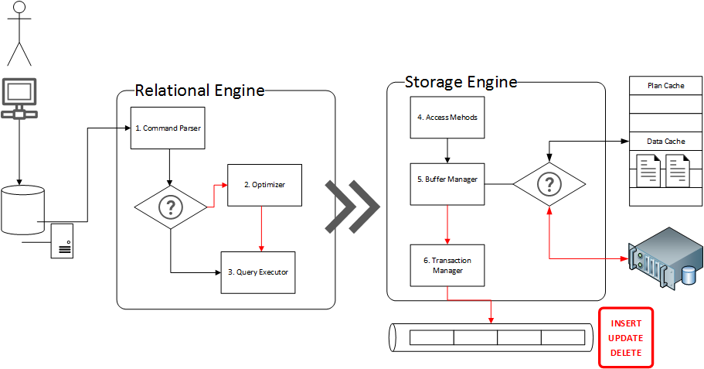

Slide 14
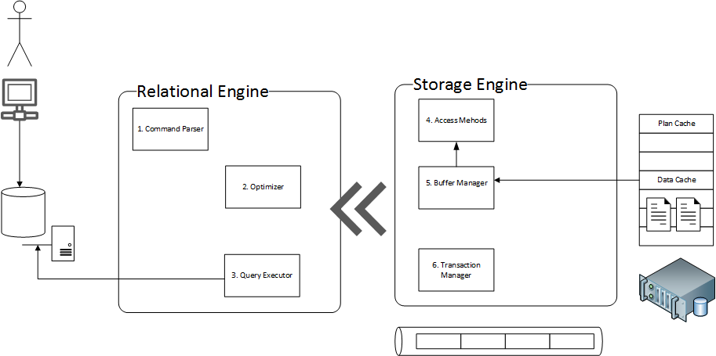

Slide 15
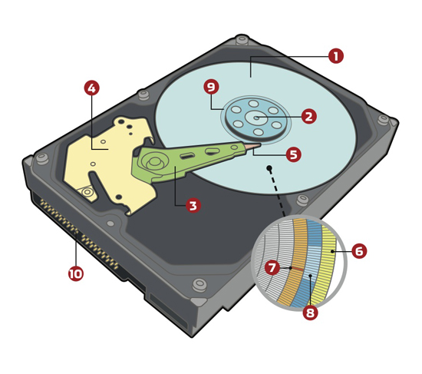
Magnetic Storage
1 Platter(s)
5 Drive Head
6 Track(s)
7 Sector(s)
8 Cluster(s)
http://www.computershopper.com/feature/how-it-works-platter-based-hard-drive

Slide 16
Magnetic Storage
Depending on how you format your partitions (cluster size), disk performance can be affected
Microsoft recommends formatting the clusters to 64K allocation units
Why? Extents are 64K in size and this can help with Read operations since tables/indexes are organizes in Extents by SQL Server
Think of clusters as data “shopping bags”
You could several huge bags to carry all your groceries
You can use even more smaller bags to carry all your groceries
Each bag costs you 5 cents from the grocery store, and all bags are equal in strength

Slide 17

Allocation Units 64KB 1 Physical read per Extent
Drive Head
Track
Sectors

Slide 18
Allocation Units 4KB 2 Physical Reads per Page
Drive Head
Sectors
Track

Slide 19
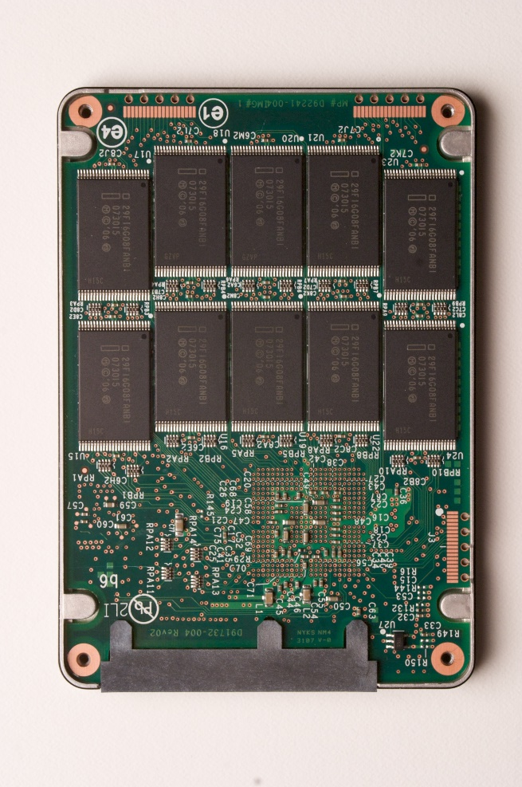
SSD – NAND Flash
64KB Allocation Units
4KB Allocation Units
http://download.intel.com/pressroom/images/InsideanSSD.jpg

Slide 20

RAID Basics
Partition1
RAID O (Zero)
Reads are divided among hard drives (multiple read heads)
http://www.smartbrandingco.com/PomPrintBlog/wp-content/uploads/2012/02/Hard_Disk1.png

Slide 21
SAN with RAID
LUN1
LUN2
LUN3
LUN4
http://www.smartbrandingco.com/PomPrintBlog/wp-content/uploads/2012/02/Hard_Disk1.png

Slide 22
RAM
Entire pages are loaded into RAM (not rows!)
Therefore if page is 50% full, 8KB of space is consumed from RAM
Image if the example below was in GB not KB
128 KB of Data in pages that are full takes up 128KB (Fill Factor 100%)
64 KB of Data in pages that are half full takes up 128KB (Fill Factor 50%)

Slide 23
How pages are stored in RAM
Using Hash Buckets
Hash Bucket
Data Cache (RAM)
Request for
Page #199
on File #1
from DatabaseID 5
Stored in reverse
DatabaseID:FileNumber:PageNumber 5:1:199
Page Info | Buffer Cache Address
1:1:200 | XYNPUG19
3:7:98 | AZX444ST1
5:1:199 | ZYNZ1GD8
2:2:17 | XYAPUG10
1:1:21 | TRW56F7F
ZYNZ1GD3 | ZYNZ1GD4 | ZYNZ1GD5 | ZYNZ1GD6
ZYNZ1GD7 | ZYNZ1GD8 | ZYNZ1GD9 | ZYNZ1GD10
5:1:199

Slide 24
Speed Assessment (Estimates Sept 2013)
Metric | DDR3 RAM | SSD (Solid State Drive) | HDD (Hard Disk Drive)
Random Access Speed or Latency (RAM) | 10ns (0.01 Microsecond) | 100 Microseconds (0.1 ms) 100,000 Nanoseconds (ns) | 4-9 milliseconds (ms) 4000-9000 Microseconds
Cost per GB | $5-$20 | $0.5-$1.00 | $0.05-$0.10
Power Consumption | 2.5-5W | 0.6W-3W (PCI-E ~20W) | 5-20 Watts
Data Transfer Rate (Peak)
SATA III (6.0Gbit/s) | N/A | 300-600 MB/s | Less than 200MB/s @ 15K RPM
PCI-E | N/A | 300-3000MB/s | N/A
DIMM | 6400-17,000+
*Drive price and specs for Single Drives not SAN Storage
*SATA III and SAS are very close in performance
*Fibre Channel connection on a SAN Speeds are between 800-4000MB/s for transfer rates

Slide 25
Picture worth 1000 MB? Pages per second on peak transfer
RAM
SSD PCI-E
SSD
HDD
10,000 Pages
50,000 Pages
250,000 Pages

Slide 26
RAM

Slide 27
Access Speed or Latency time
Every nanosecond you waste, a cookie is burned in someone’s oven
RAM
SSD
HDD
1 Cookie
10,000 Cookies
1,000,000 Cookies

Slide 28

What about compression?
Affects CPU usage (negatively but not very noticeable)
Pages are the decompressed and take same space in RAM
So why do it? Saves I/O which is the real bottleneck!
Just think of the math. It will take X% less time to push compressed data from disk to RAM. X% is compression rate.
64KB pages
compressed down
to 32KB (50%)
32KB pages
decompressed
to 64KB
Transfer 32KB Decompress

Slide 29
Why does all this matter?
We are Geeks, we should be excited by this stuff, the world depends on us!
Truth is, the CPU is a busy worker on the system that pulls data from RAM
Data from disk goes to RAM, and it is the main bottle neck for performance
The slower the data request goes from CPU – Disk – Back to CPU the slower work is performed

Slide 30
CPU does all the “Thinking”
Requests data from disk
Disk returns data to Memory via Direct Memory Access Memory pushes data to CPU via Front Side Bus
RAM
CPU
North Bridge
(Memory Control)
FSB
For SQL Server, when the pages
are kept in memory, they can be
brought back from memory without
having to go to disk.
VIA DMA
SATA/SAS PCI-E
South Bridge
(I/O Control)

Slide 31
Monitoring
Windows: Perfmon
SQLServer:Buffer Manager
Buffer Cache Hit Ratio ~ 90%
Page Life Expectancy ~ 600+ (it depends)
SQLServer:Memory Manager
Database Cache Memory (KB) – How much are we using?
Memory Grants Pending = 0
Target Server Memory –how much SQL Server could use
Total Server Memory – how much SQL Server is using
SQLServer:SQL Statistics
SQL Compilations/sec & Batch Requests/sec
Find the ratio between them (Compilations/Batch Requests)

Slide 32
From SQL Server Data Management Objects
SQL Server DMOs
General: Sys.dm_os_process_memory & sys.dm_os_sys_memory
Sys.dm_os_buffer_descriptors – row for everything in the buffer
Get per DB:
DBCC MEMORYSTATUS – more than you know what to do with

Slide 33
Q&A
Ayman El-ghazali-www.thesqlpro.com-@thesqlpro

